Slide 1
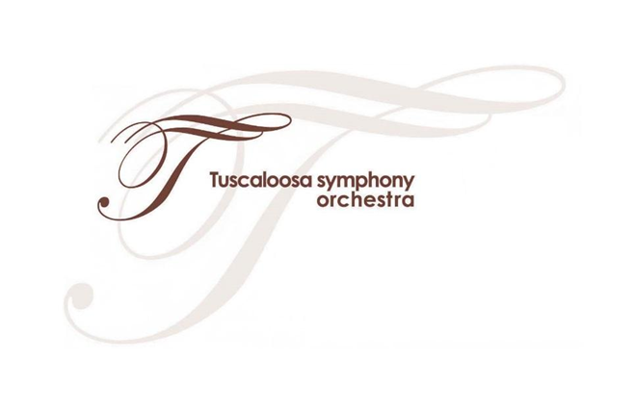
Let’s Learn More About the People and Places Behind the Show!

Slide 2
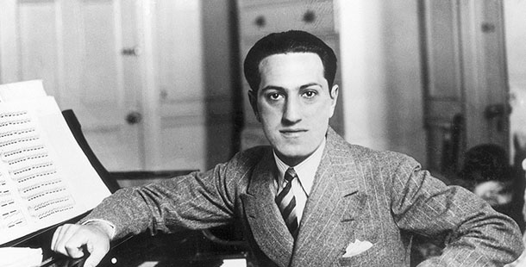
George Gershwin (1898-1937) was an American composer and pianist who accomplished a lot during his short life. He was born in New York City and eventually dropped out of high school to compose music professionally. Some of his most famous pieces include Rhapsody in Blue, An American in Paris, and the folk opera Porgy and Bess.

Slide 3
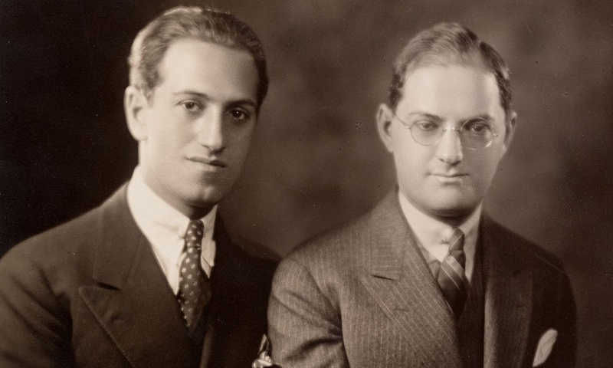
Gershwin’s older brother, Ira, was a famous lyricist. A lyricist is someone who writes the words (called ”lyrics”) for songs. Ira wrote lyrics to some of George’s music. Have you ever worked with your brother or sister on a project?

Slide 4
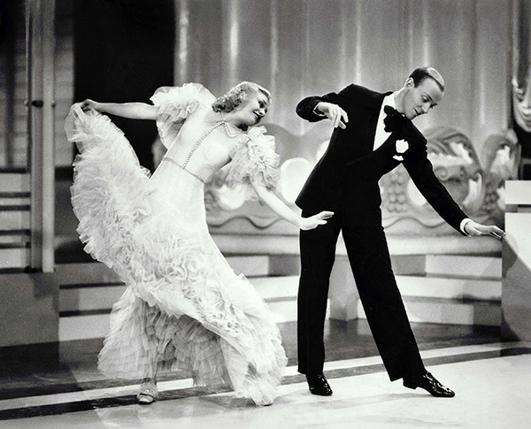
The piece “Walkin’ the Dog,” which you will hear the TSO perform, was written for a movie called Shall We Dance, starring two of the most famous dancers of all times, Ginger Rogers and Fred Astaire.

Slide 5
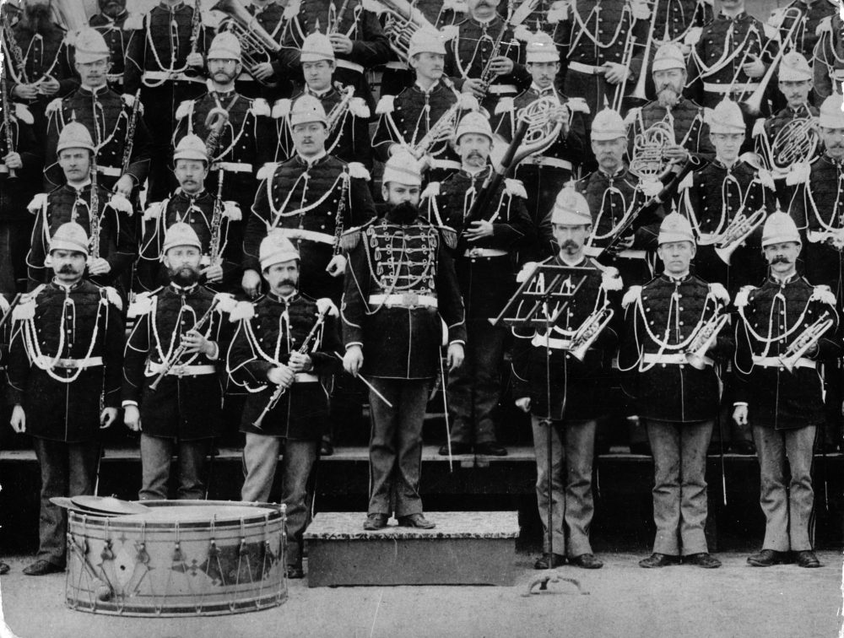
John Philip Sousa (1854-1932) was an American composer and conductor mostly known for writing military marches. He directed the United States Marine Band for 12 years. At the concert today, you will hear one of his famous marches, Hands Across the Sea. Here is Sousa in a photo with the Marine Band.

Slide 6
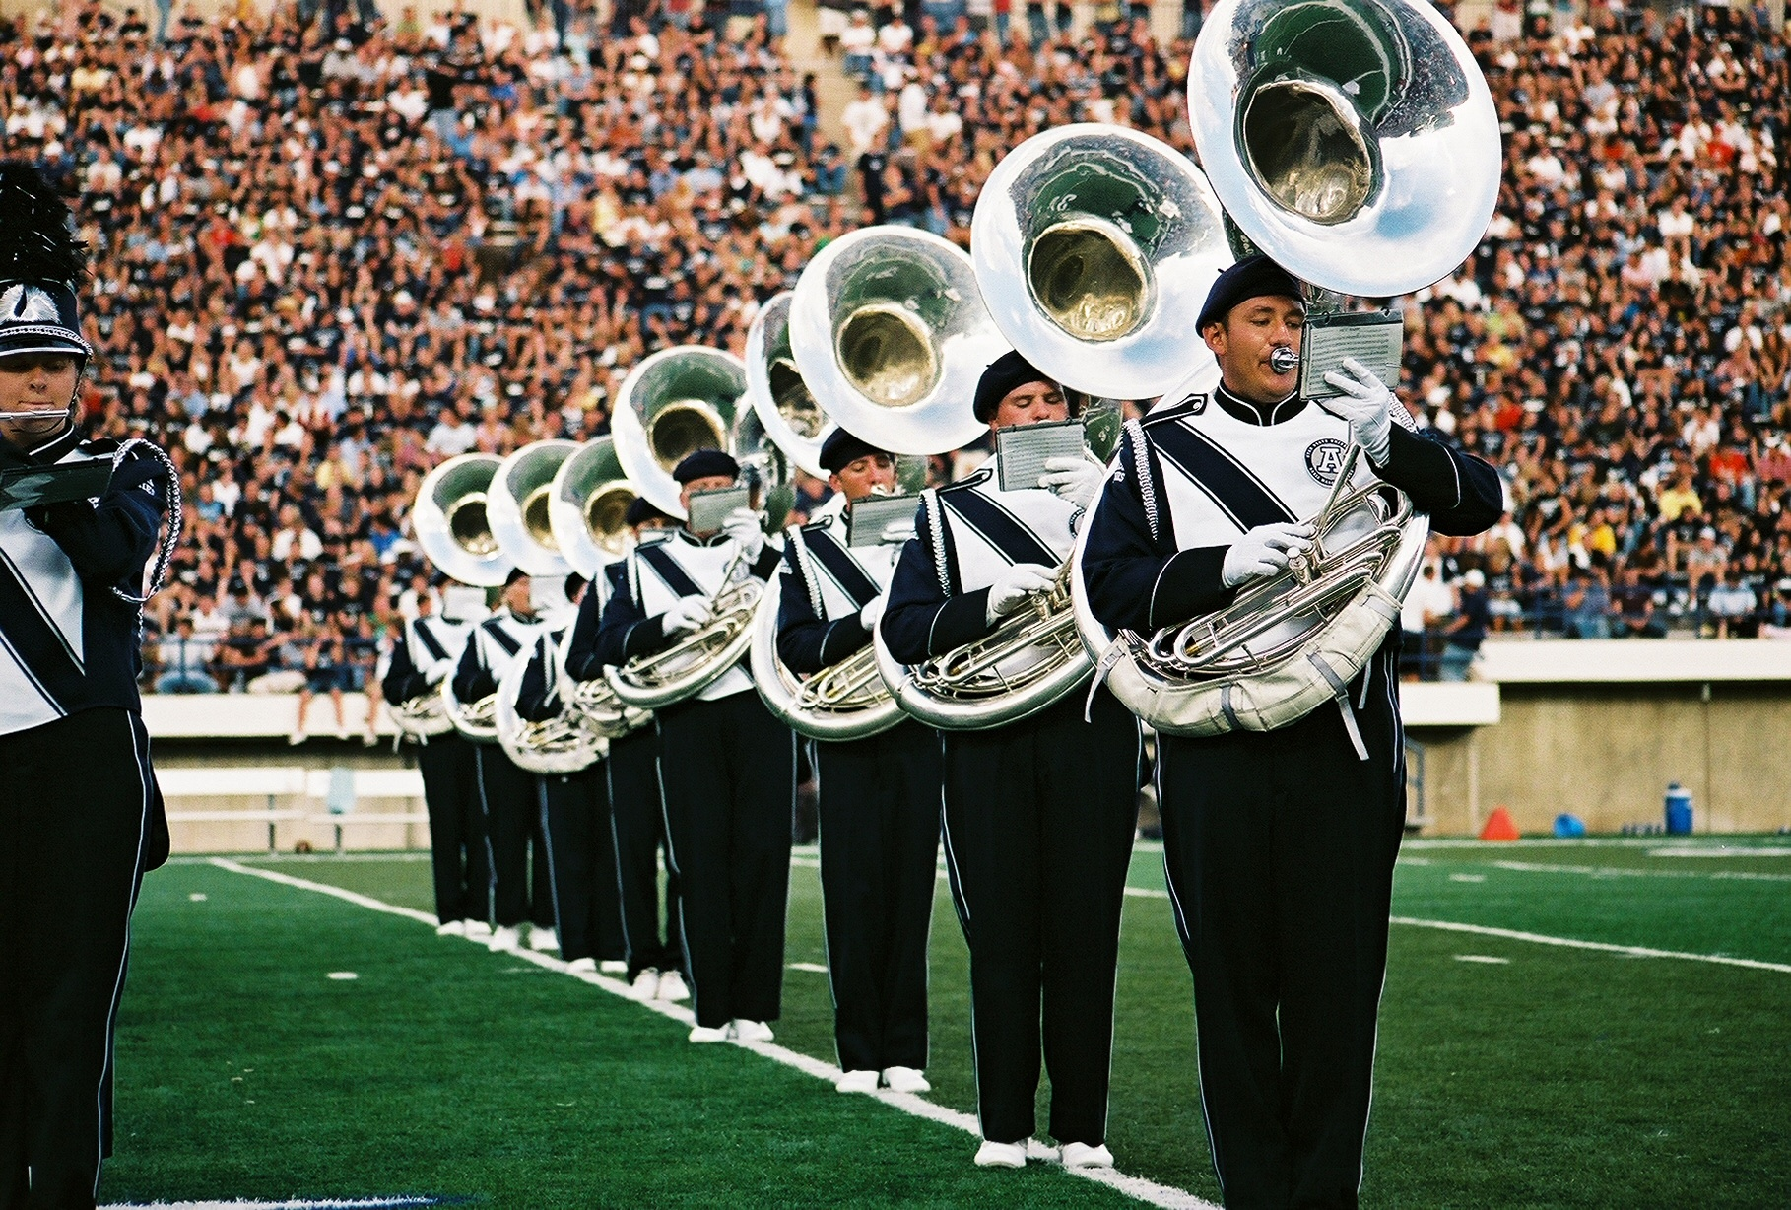
Sousa is also known as one of the inventors of an instrument that is named after him – the sousaphone! The sousaphone was designed so that the tuba – which is heavy and difficult to carry – could be used in the marching band.

Slide 7
Before we explore some of the other pieces you will hear in the Tuscaloosa Symphony performance, let’s listen to what is perhaps Sousa’s most famous march, Stars and Stripes Forever.
Have you heard this piece before? Where were you when you heard it? How does this piece make you feel, and what do you think Sousa wrote it for?

Slide 8
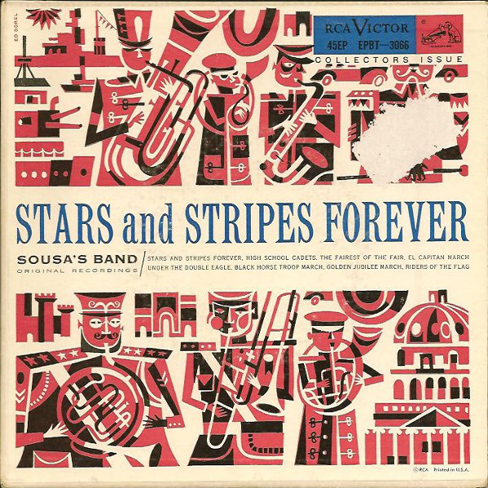
https://www.youtube.com/watch?v=4ZLr1SG8Ig4

Slide 9
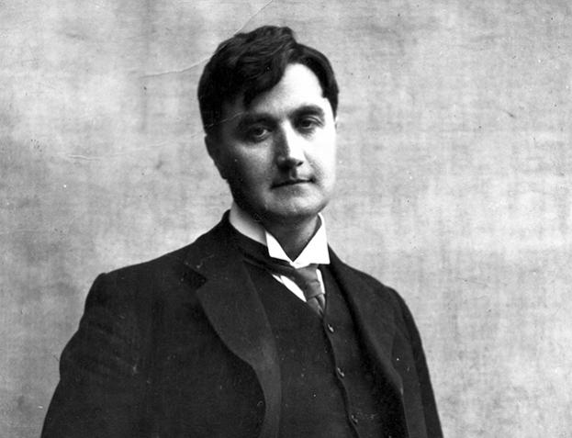
In the TSO show, we will travel from the United States to England, where we will hear Fantasia on Greensleeves by British composer Ralph Vaughan Williams, who lived from 1872-1958.

Slide 10
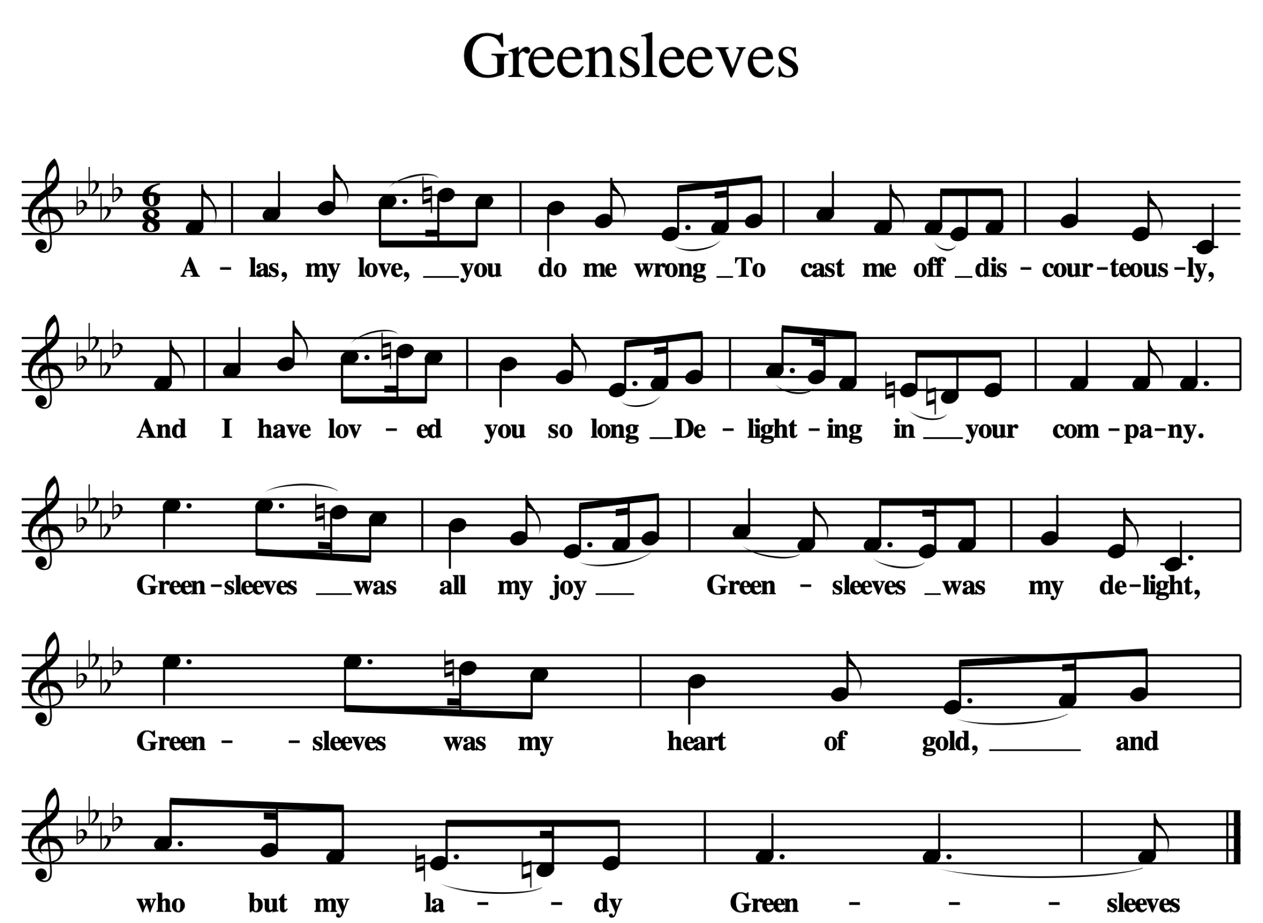
When a composer writes a “Fantasia,” he or she takes a melody that already exists and expands on it – to make it his or her own. This piece is based on “Greensleeves,” an English tune that you may have heard before. Let’s listen. At what time of year have you heard this melody before?
https://www.youtube.com/watch?v=P5ItNxpwChE

Slide 11
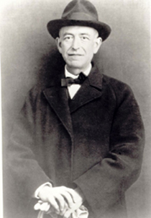
From England, we travel to Spain, where we will hear a Spanish Dance composed by Manuel de Falla – a composer so famous in his country that he appeared on money! de Falla lived at the same time as Vaughan Williams. During the show, think about how their style of music is similar and different.

Slide 12
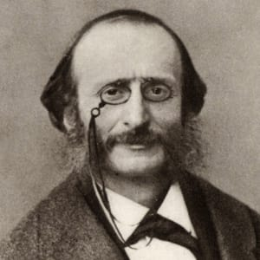
Next, we travel to France, where we meet composer Jacques Offenbach, who lived from 1819-1880. He is most famous for his operetta based on Greek mythology, Orpheus in the Underworld. This operetta contains a melody you may know as the “Can Can.”

Slide 13
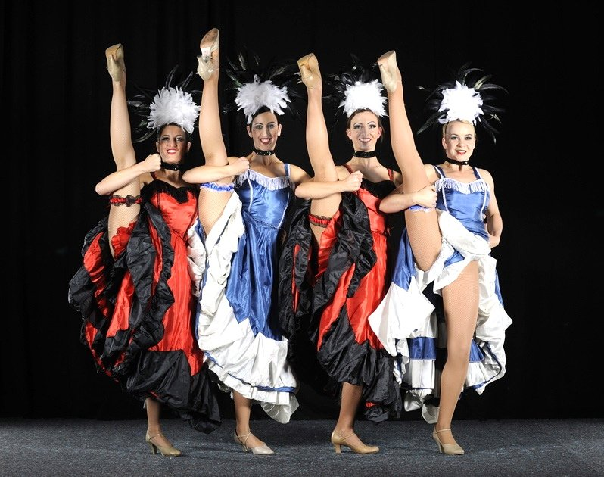
You will probably recognize Offenbach’s “Can Can” during the concert, but “Can Can” is actually a general term for a brisk French dance, featuring high kicks and cartwheels!

Slide 14
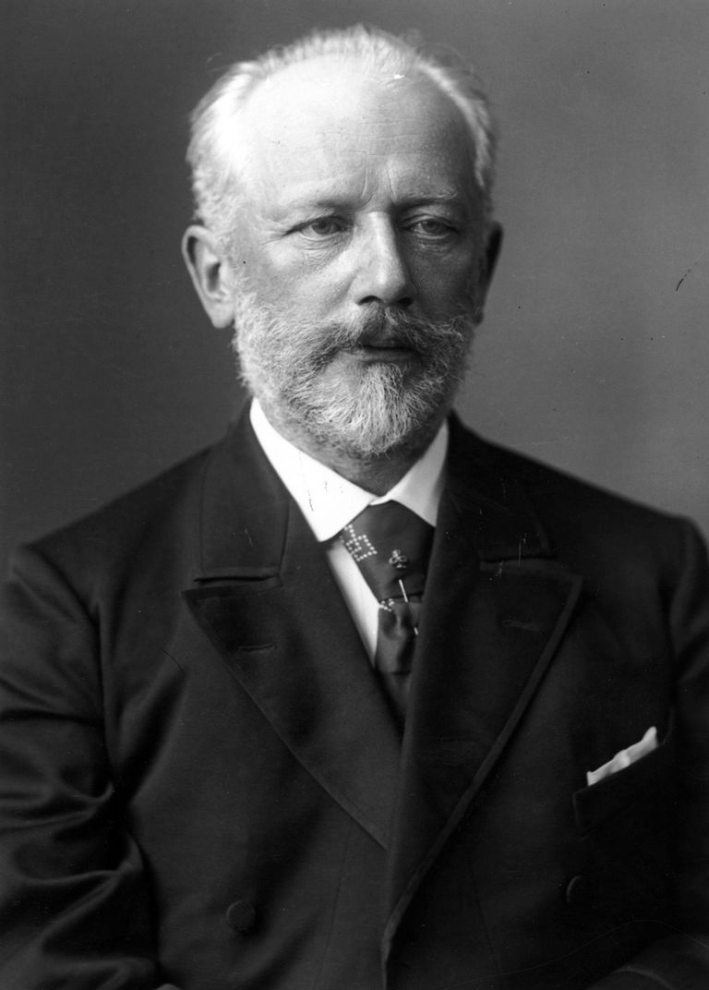
From France, we move to Russia, where we meet composer Pyotr Ilyich Tchaikovsky (1840-1893). He began studying the piano when he was just five years old, and started writing his own music when he was fourteen. He wrote some of the most popular music to ever come out of Russia, but he often struggled with writer’s block! Can you think of a time when you had an idea that you just could not put down on paper?

Slide 15
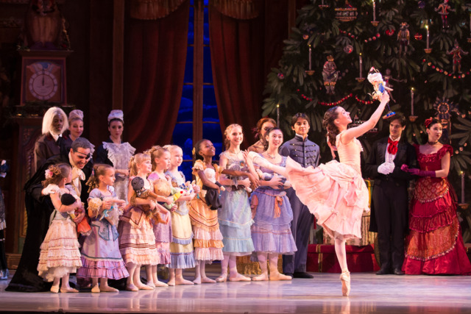
One of Tchaikovsky’s most well-known works is a ballet called The Nutcracker, which is often performed during the holiday season.

Slide 16
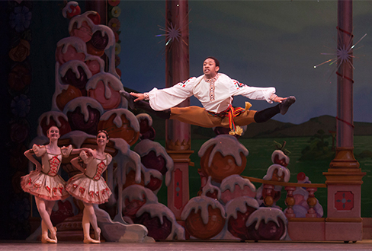
The Nutcracker is filled with dances inspired by the music of many countries – including Spain, China, and Saudi Arabia. At the TSO concert, you will hear a piece from the ballet that was inspired by a style of dance from Tchaikovsky’s native Russia – the “Trepak.” You may recognize it. Let’s listen, and imagine what the dance might look like: https://www.youtube.com/watch?v=z2ISRMSIyX8

Slide 17
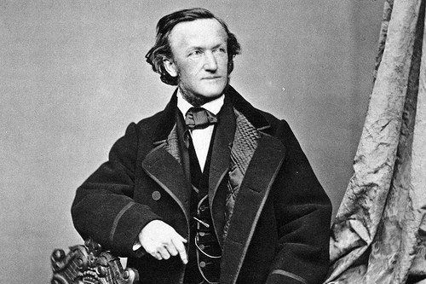
Next we move to Germany, where we hear the music of Richard Wagner (1813-1883). Wagner is most known for his operas, which he called “music dramas.” Wagner wrote the lyrics and the music to all of his operas. At the performance, we will hear ”Ride of the Valkyries” from the opera Die Walküre, which means “The Valkyries” in German.

Slide 18
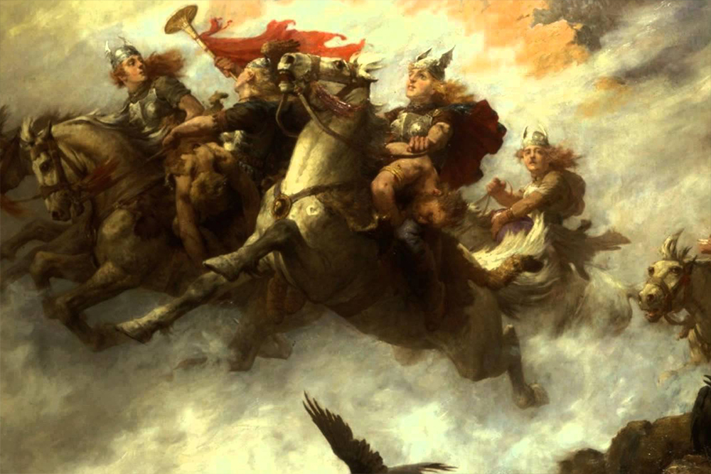
The Valkyrie comes from Norse mythology, and is a woman figure who decides who lives and who dies in battle. Composers, writers, and painters often use them in their work. In Wagner’s opera, this music goes along with a scene change behind the curtain, so the audience has to imagine the ride of the warrior women as the orchestra plays the dramatic music!

Slide 19
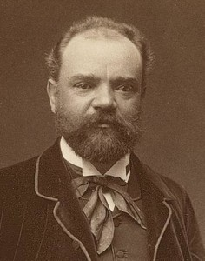
Before we head home to Alabama, we will hear the music of Antonin Dvorak (1841-1904), a composer from what is now the Czech Republic. Although he spent most of his life in Europe, he lived in New York City for three years where he directed the National Conservatory of Music. While there, he wanted to find out all about American music.

Slide 20
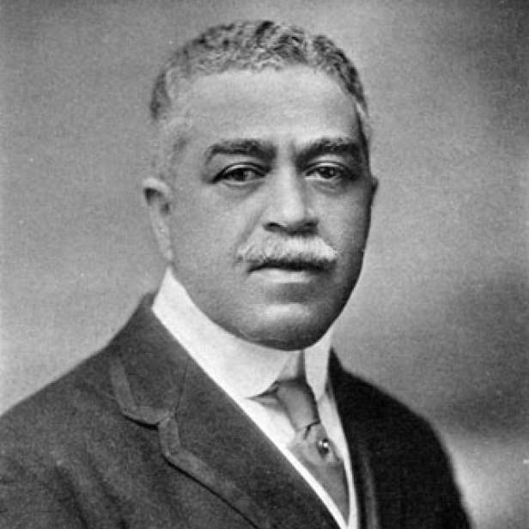
While in New York, Dvorak met Harry Burleigh, an African-American composer and musician who introduced him to the spiritual. Dvorak used African-American spirituals as inspiration for his famous Symphony no. 9, which you will hear at the performance.

Slide 21
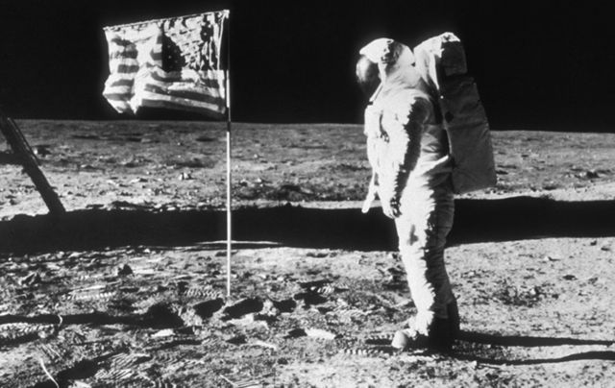
When Neil Armstrong landed on the moon in 1969, he took a recording of Dvorak’s Symphony no. 9, also known as the “New World Symphony,” with him. The part you will hear at the concert was eventually turned into a song called “Goin’ Home.” Let’s listen to part of that song. How does it make you feel?
https://www.youtube.com/watch?v=0FMUttpSllY

Slide 22
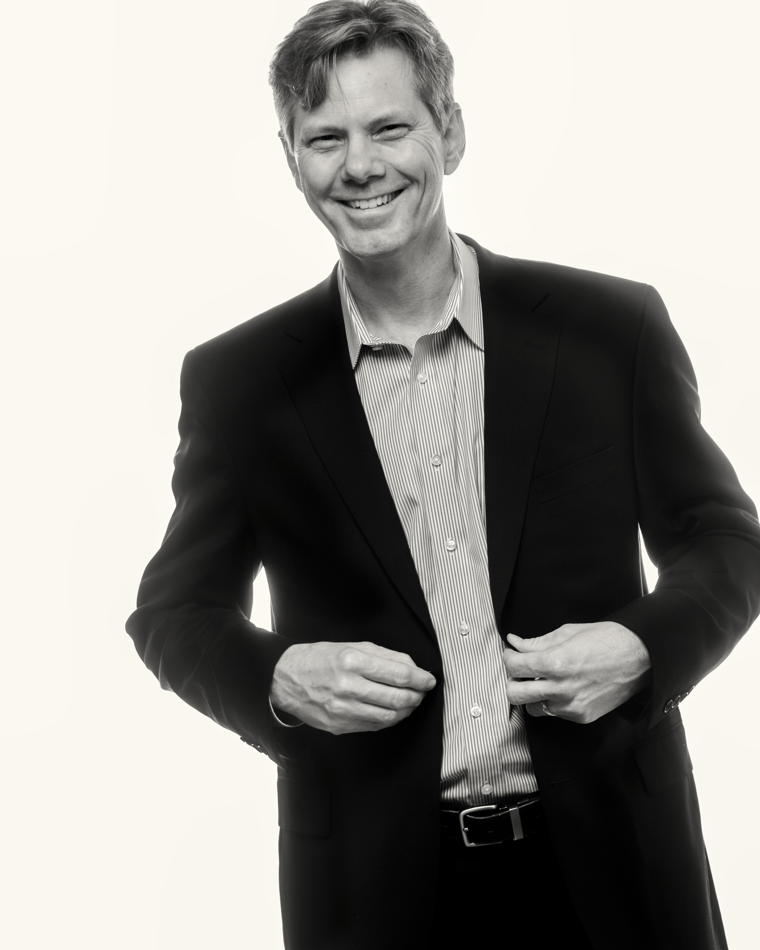
Adam Flatt

Slide 23
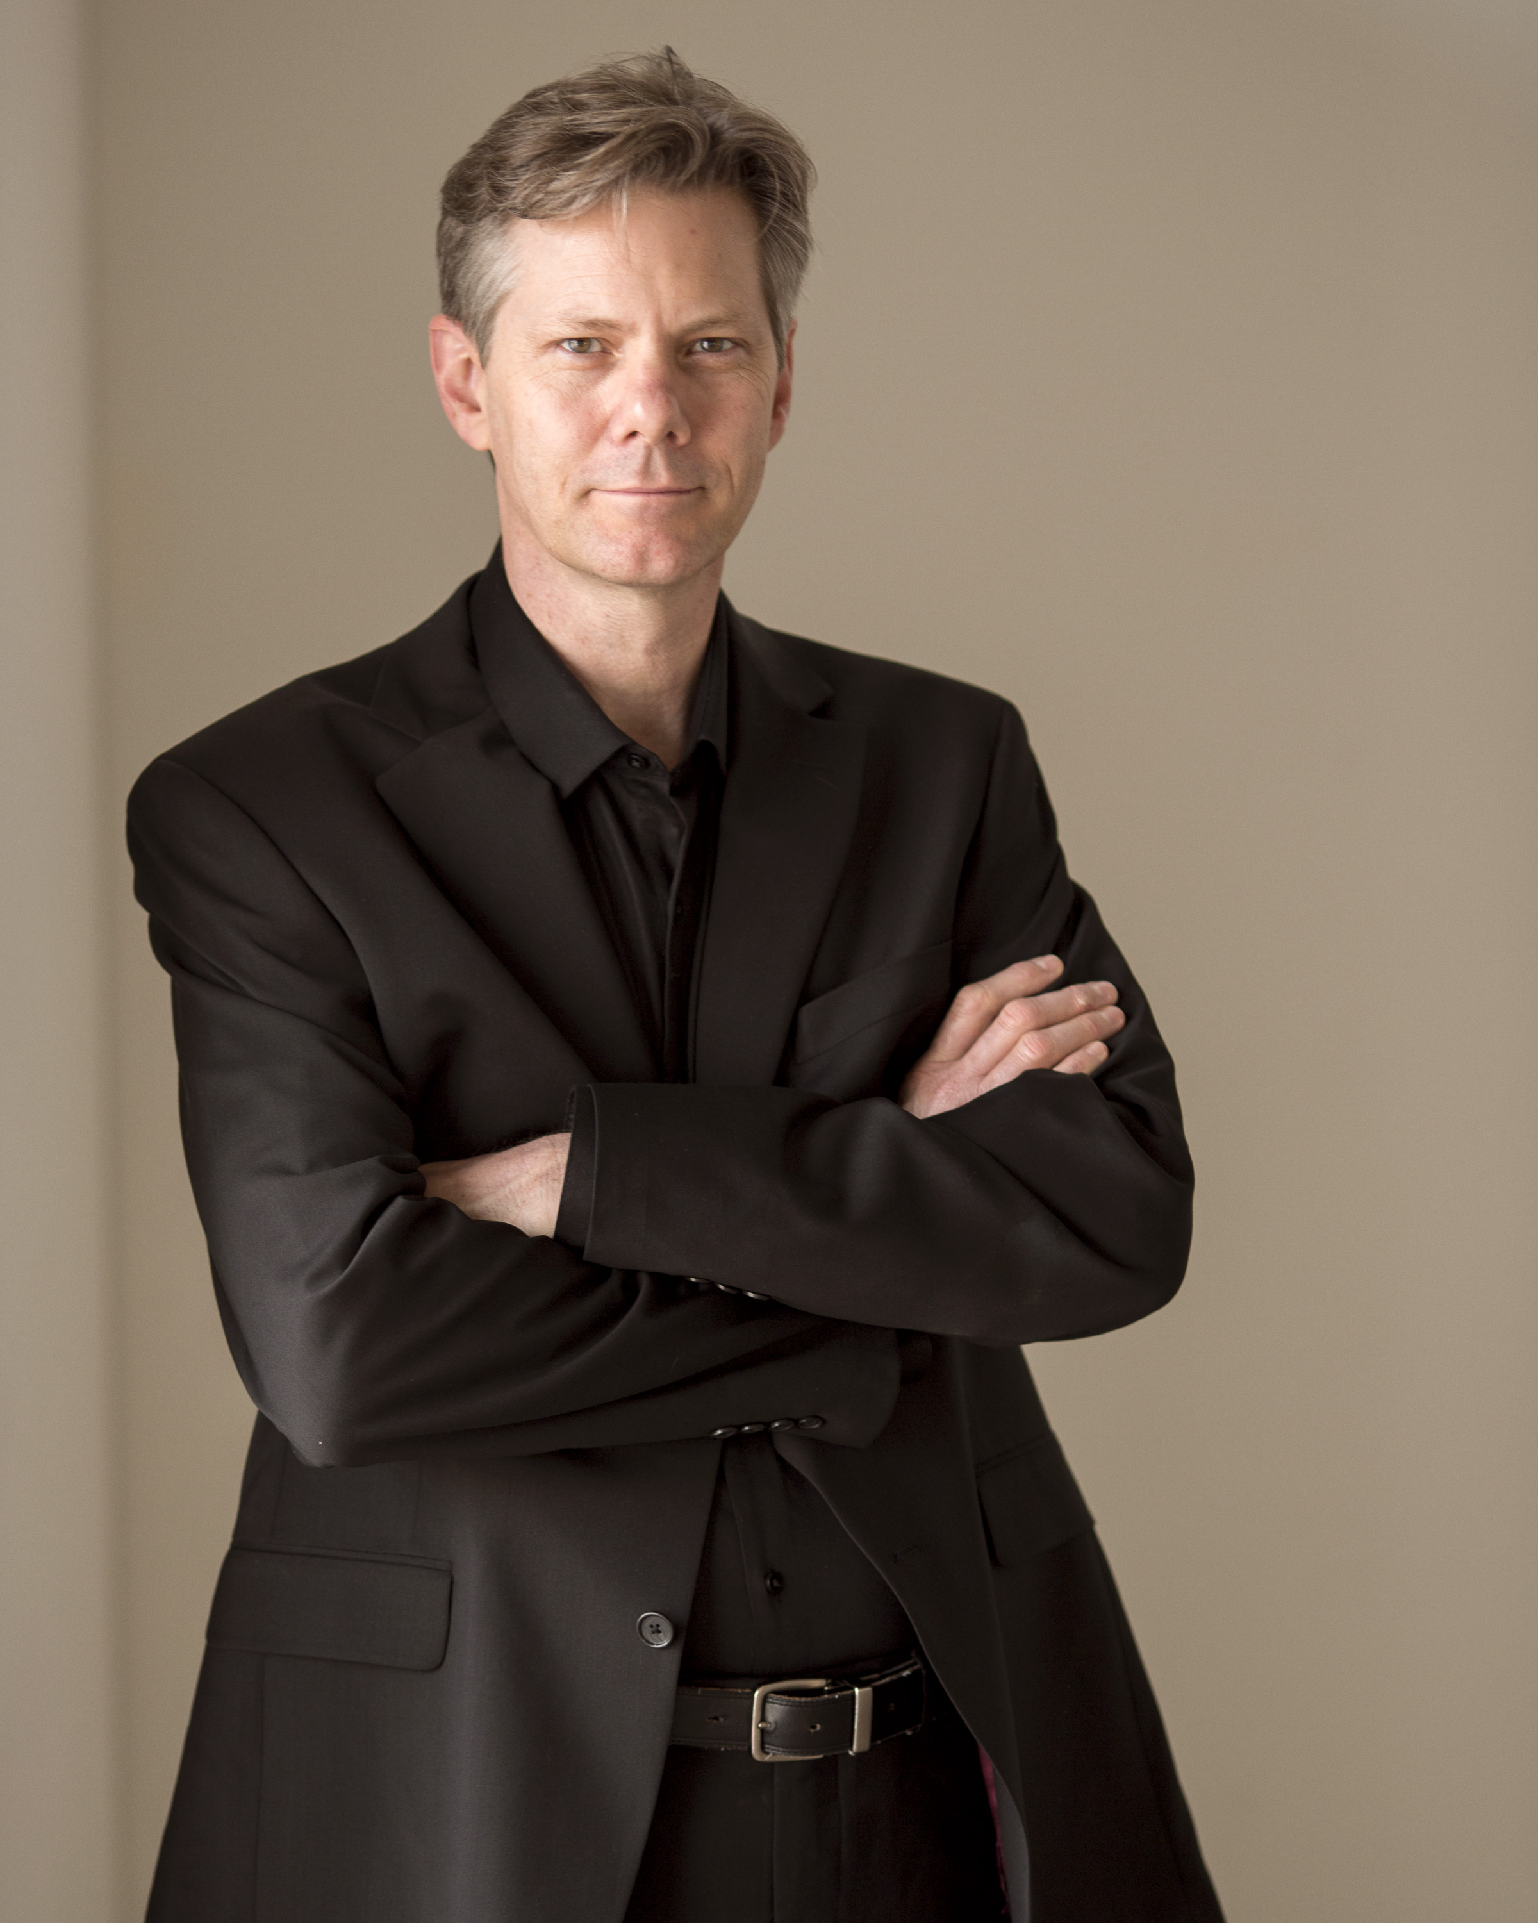
Adam Flatt is the music director and conductor of the Tuscaloosa Symphony. He is from California and now lives in Colorado. His job is to lead the orchestra and choose the music it plays. He has conducted all over the U.S. and the world. You will meet him at the concert!

Slide 24
Theatre Tuscaloosa

Slide 25
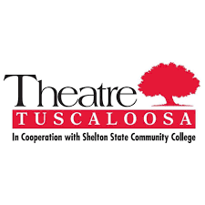
Theatre Tuscaloosa is one of the largest community theatre companies in Alabama, and began putting on plays and musicals in 1971. The actors often collaborate with musicians, like those in the Tuscaloosa Symphony Orchestra, to put on shows for children and their families.

Slide 26
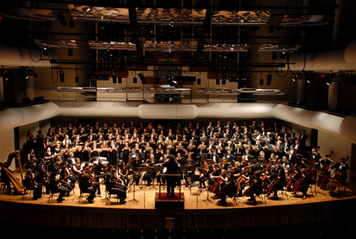
Tuscaloosa Symphony Orchestra
.

Slide 27
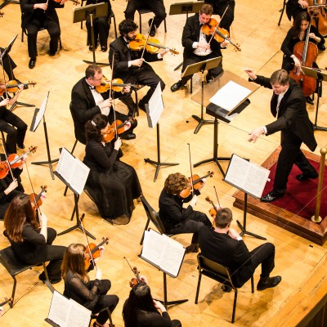
The Tuscaloosa Symphony Orchestra is made up of professional musicians. Being a professional musician takes a lot of practice and dedication. Most members of the TSO have been playing their instruments for 15 years or more.
Members of the TSO have to audition in order to play in the orchestra. Only highly-trained musicians are given the opportunity to join the orchestra.
Some musicians in the TSO come from far away to play for you! Many of the musicians come from Birmingham, AL, Nashville, TN, New Orleans, LA, and Atlanta, GA, but many live in Tuscaloosa.

